Slide 1

SMR Thermal Loop Ideas
Austin Downey

Slide 2
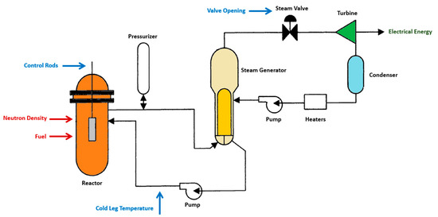
The main idea
Keep it,
Safe
Simple
Easy
Clean
Basic idea, from the paper “Real-Time Simulation of a Small Modular Reactor in-the-Loop within Nuclear-Renewable Hybrid Energy Systems”
https://www.mdpi.com/1996-1073/15/18/6588

Slide 3
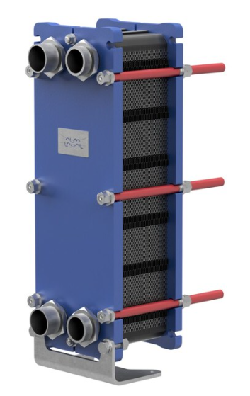
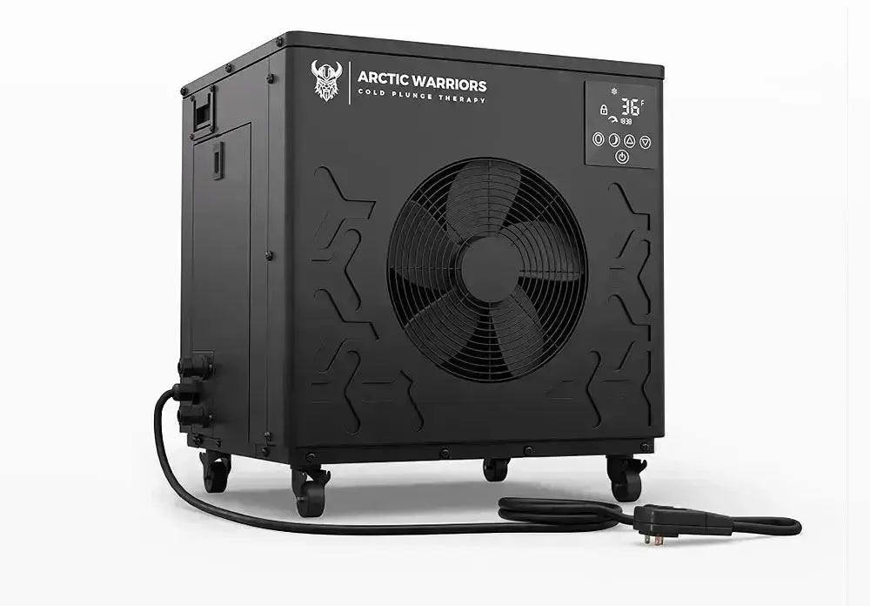
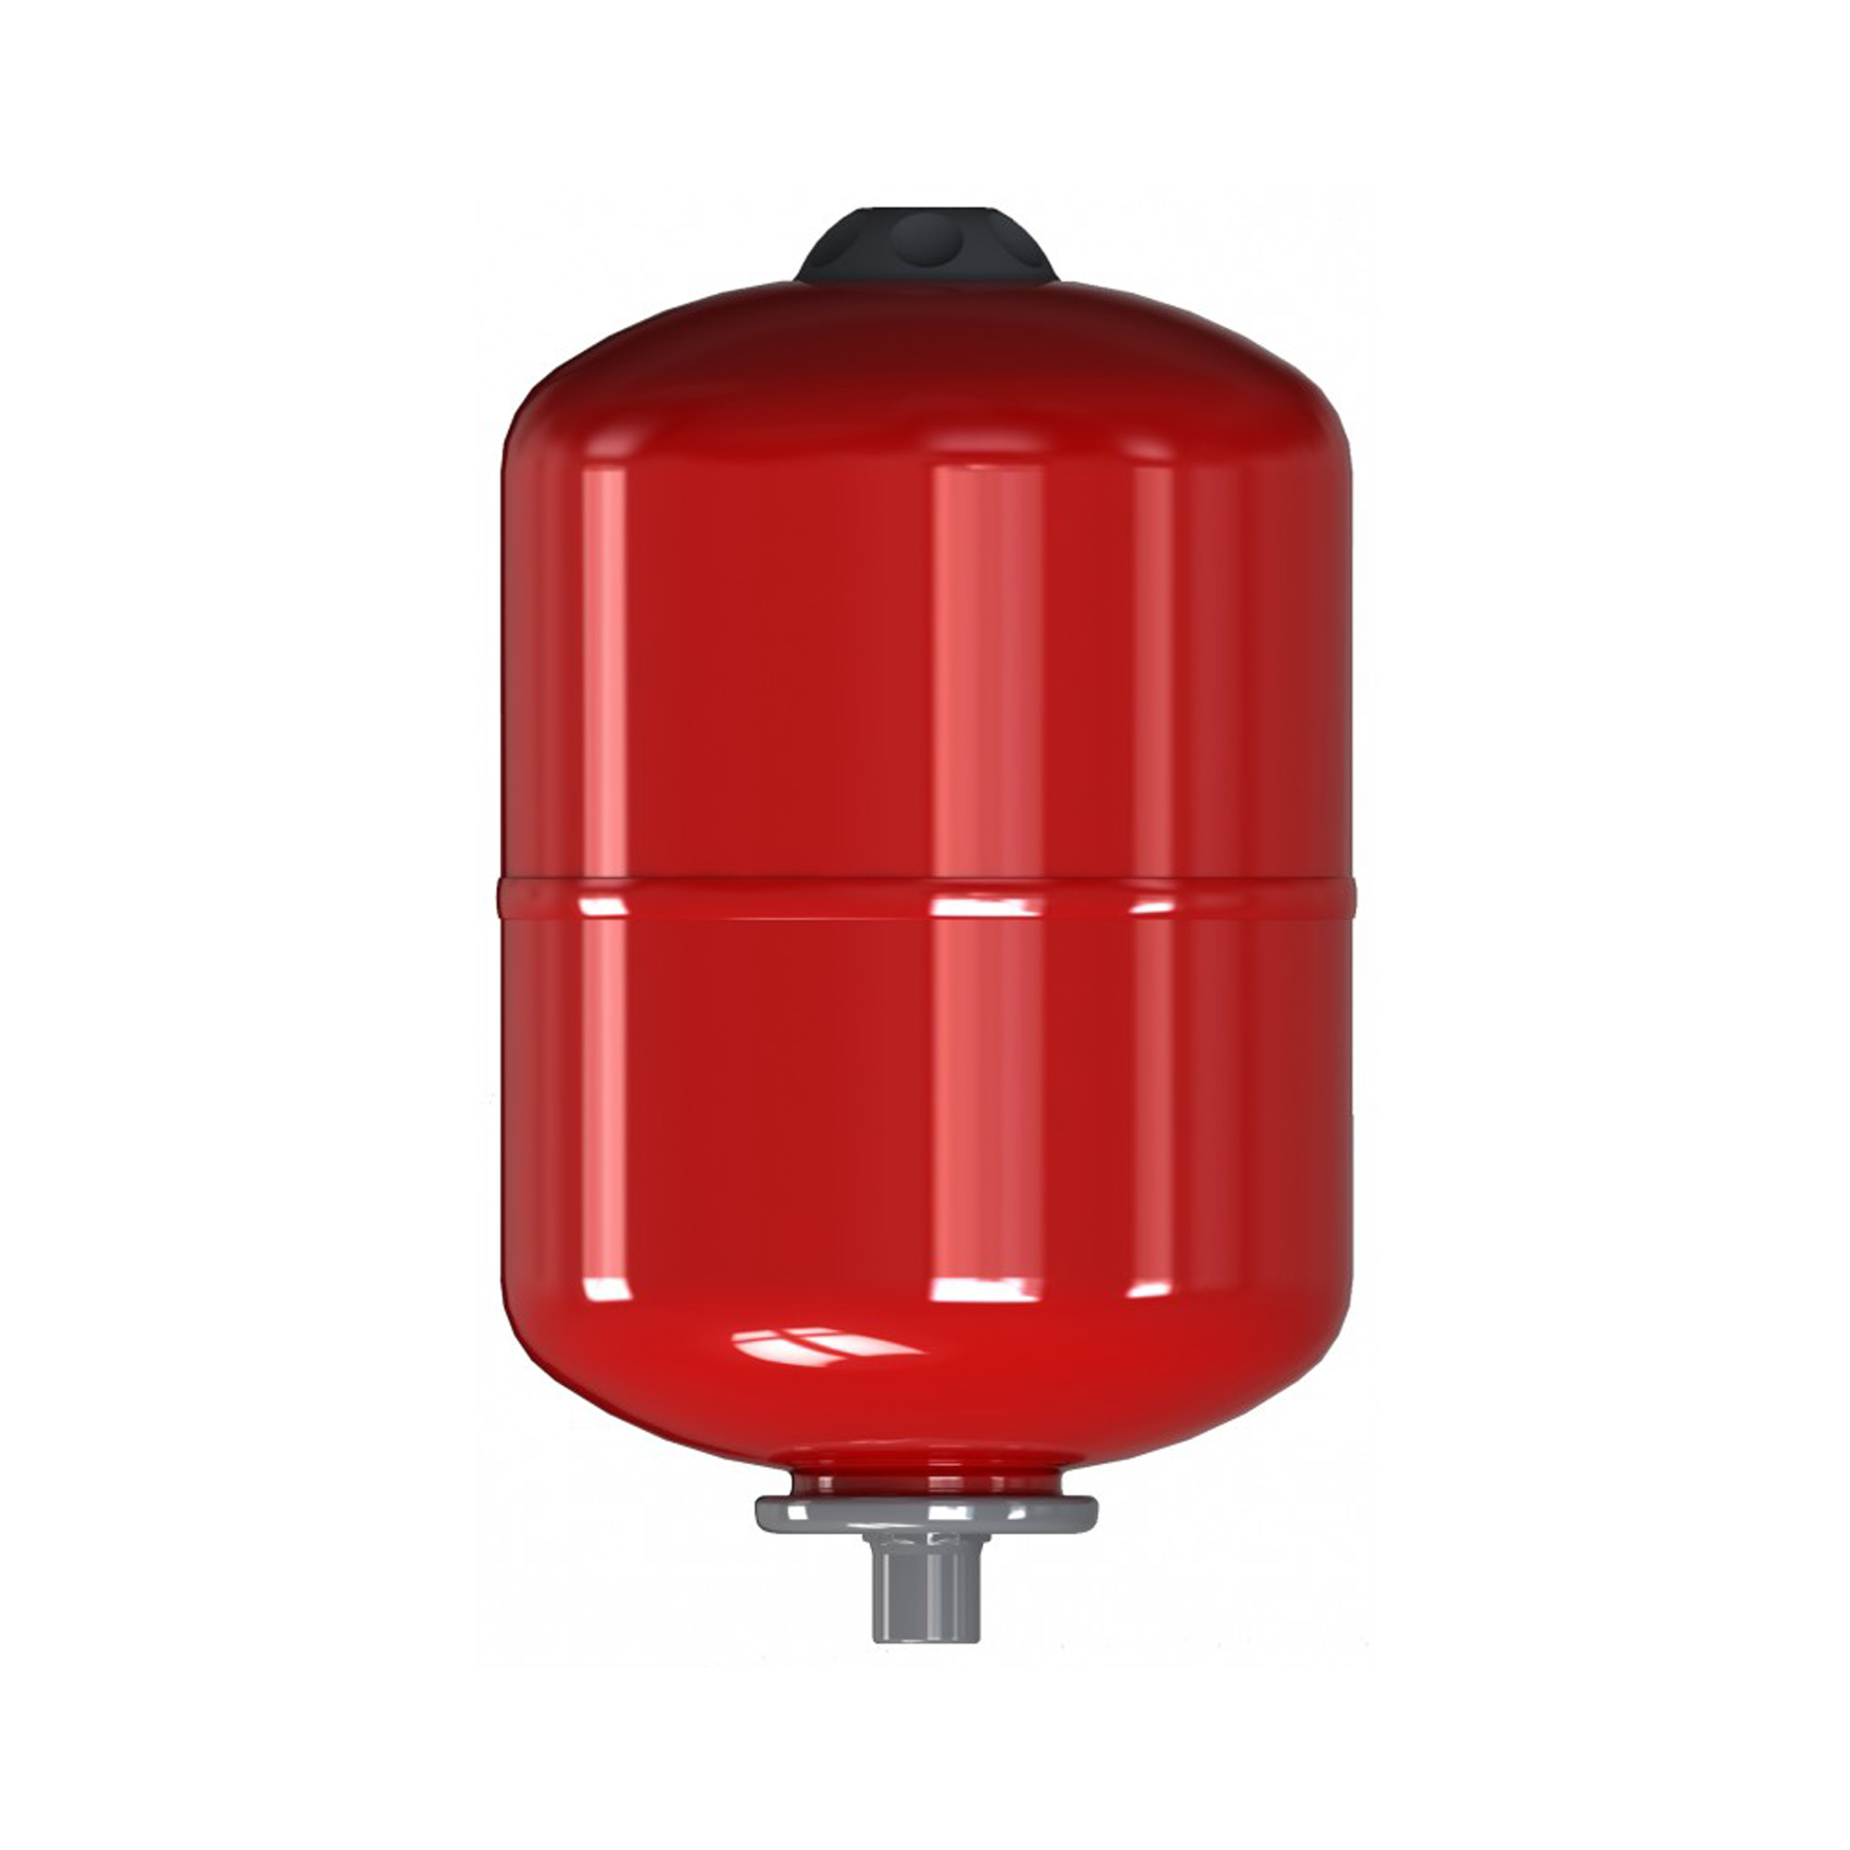
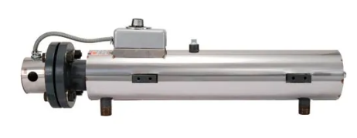
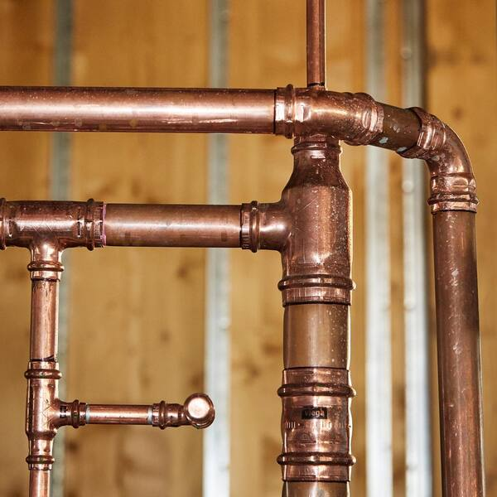
Our version
Plate heat exchanger
pressure tank
chiller
2” pro press line
Inline heater

Slide 4
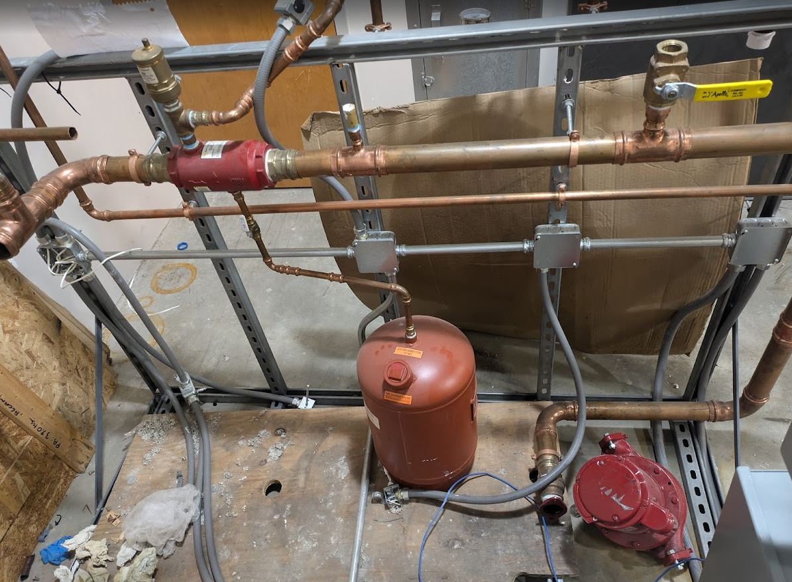
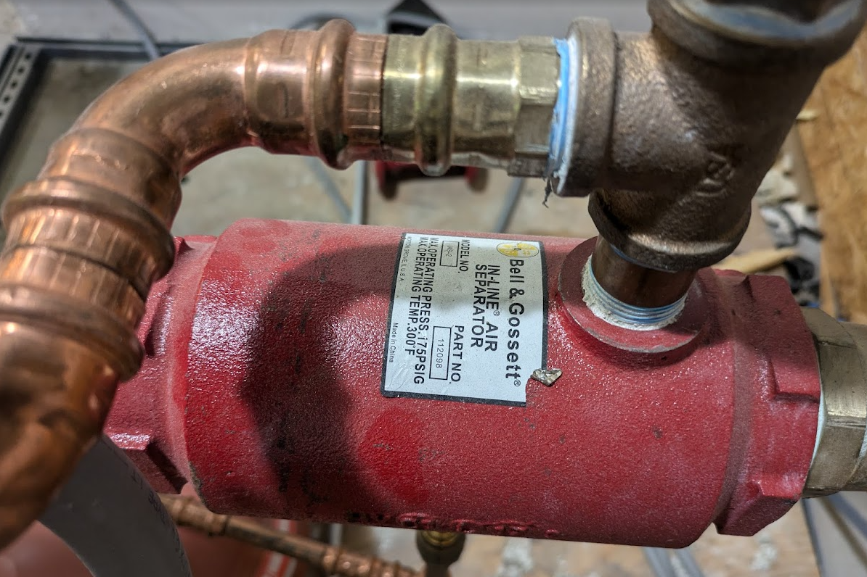
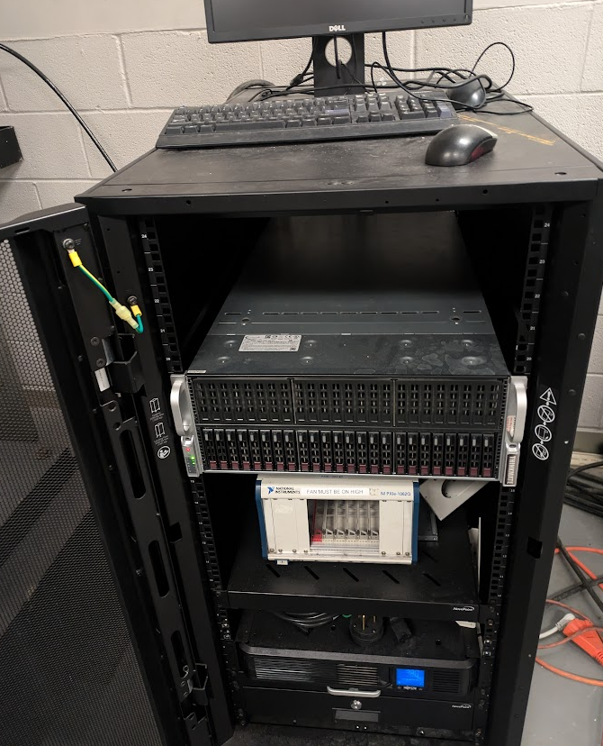
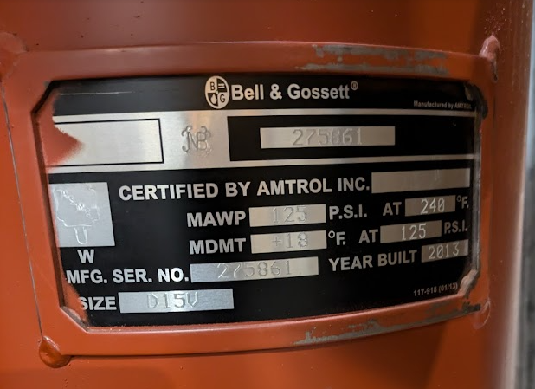
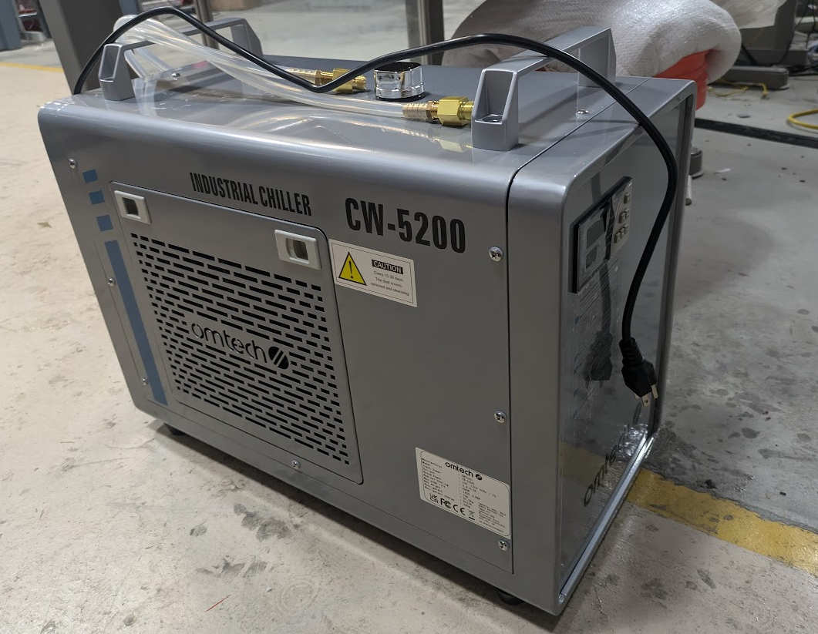
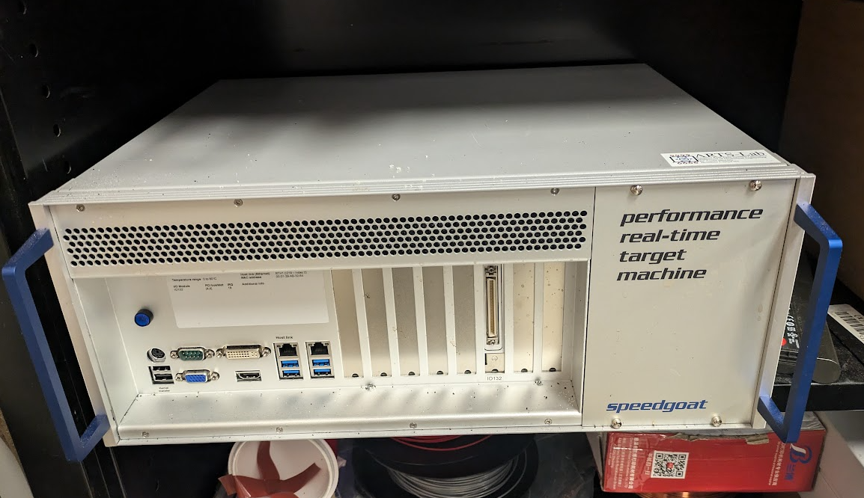
Hardware we have for use

Slide 5
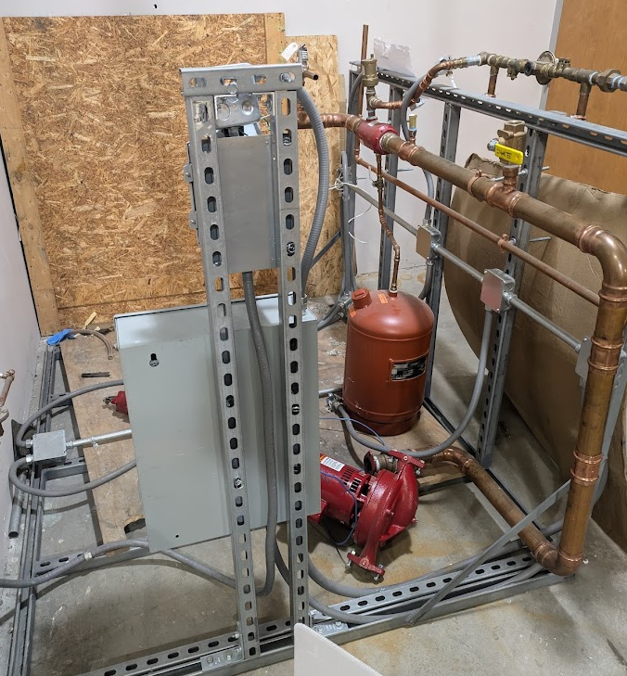
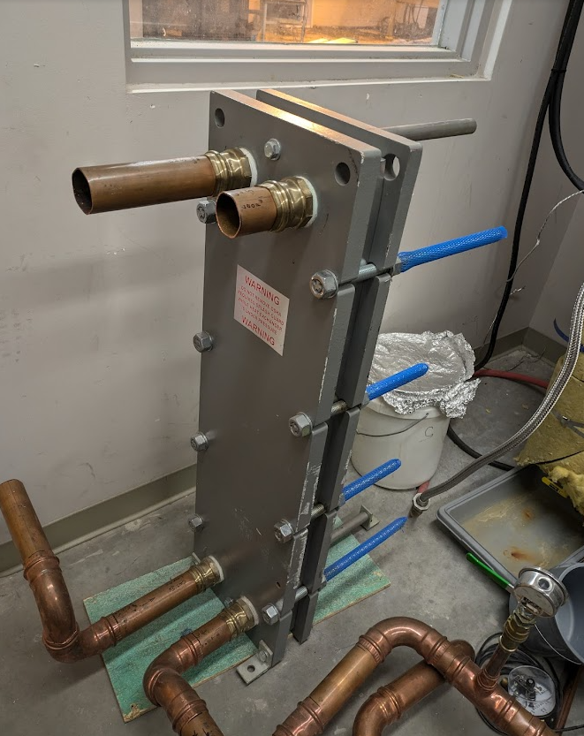
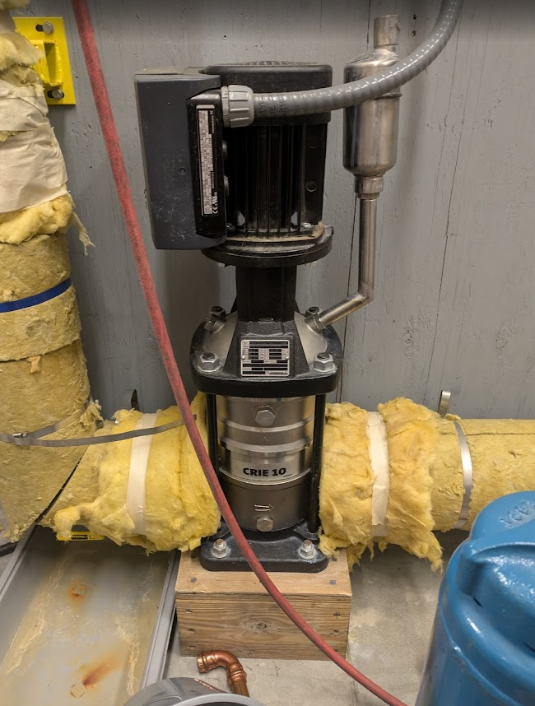
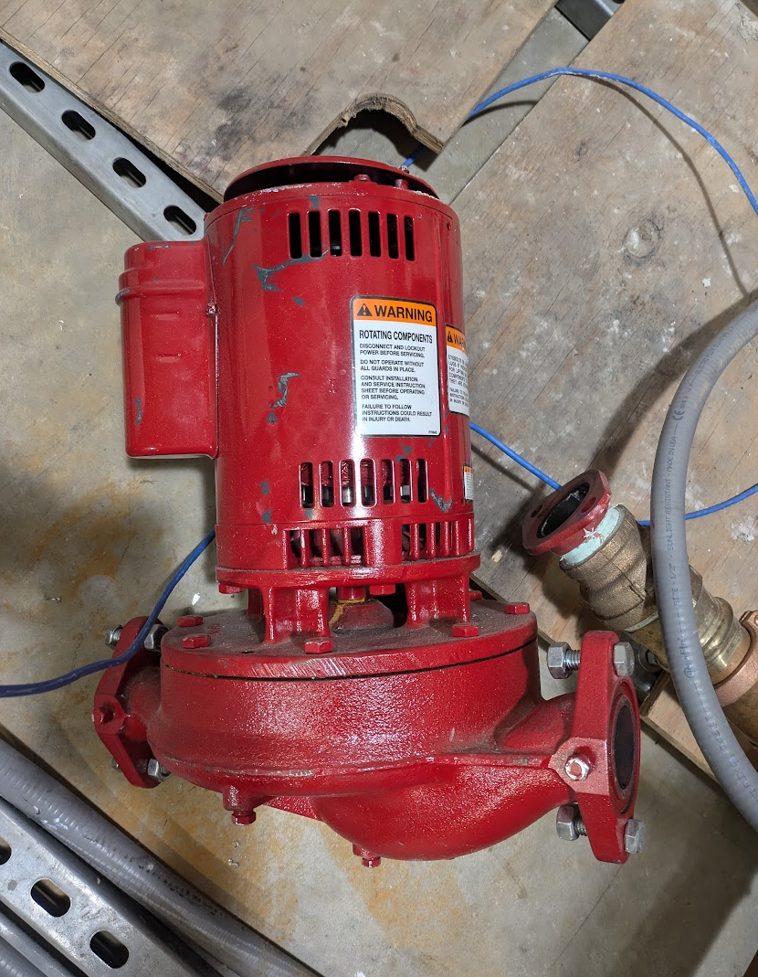
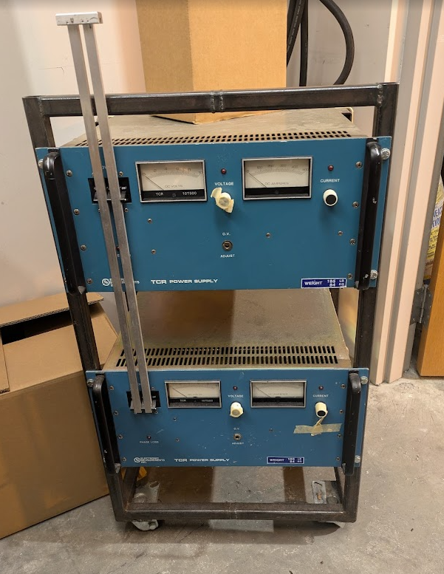
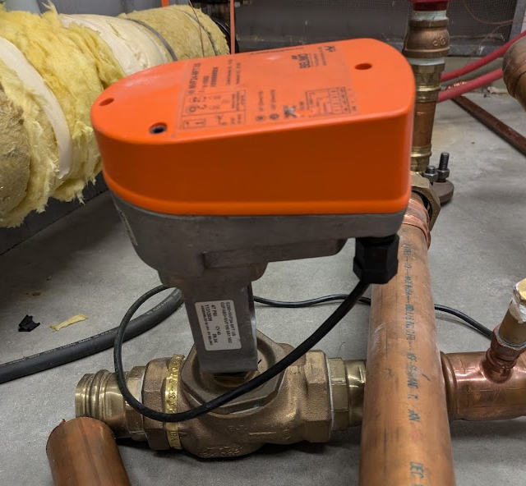
Hardware we have for use

Slide 6
Thank You for Your Time
Name: Ausitn Downey
Title: Associate Professor
Email: austindowney@sc.edu
Lab GitHub: github.com/arts-laboratory

